Slide 1
A Look into 120 Years of Olympic Data
By: Allen Baiju

Slide 2
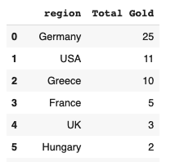
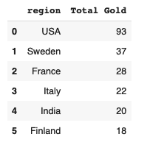
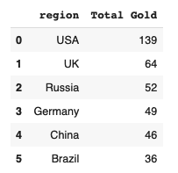
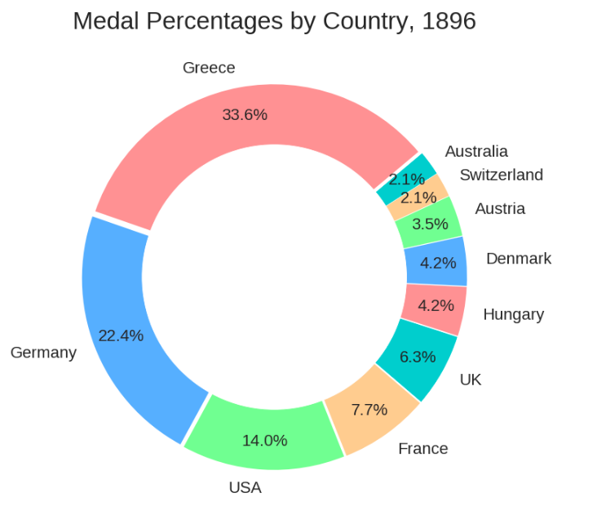
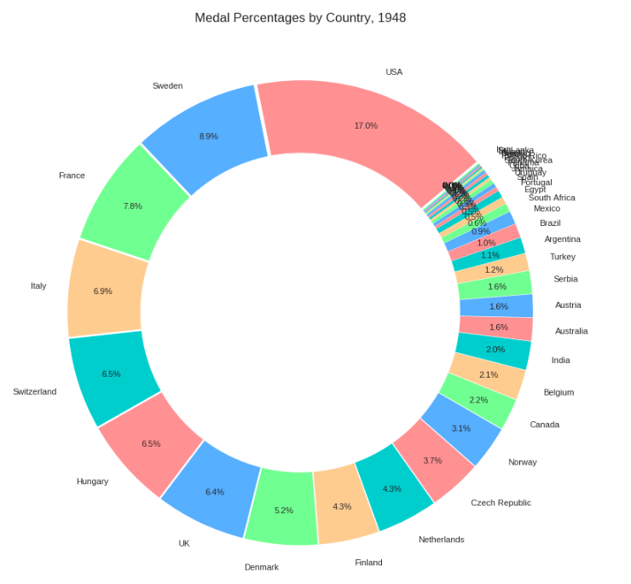
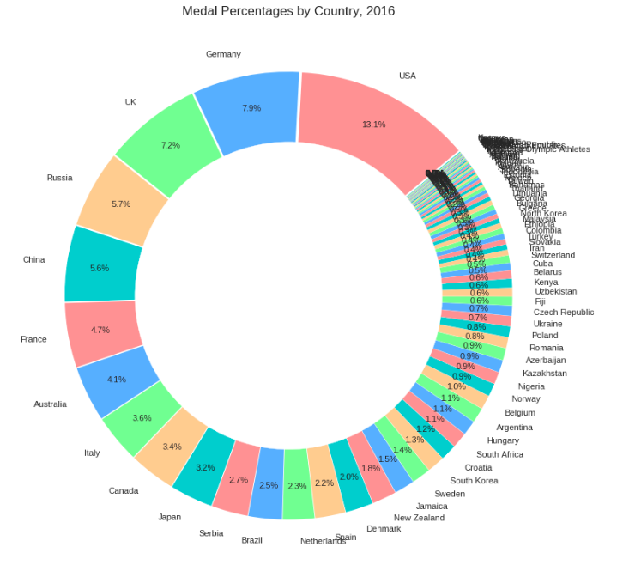

Slide 3
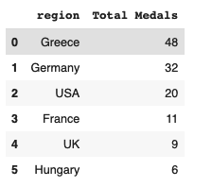
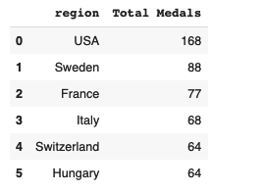
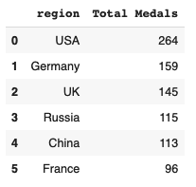
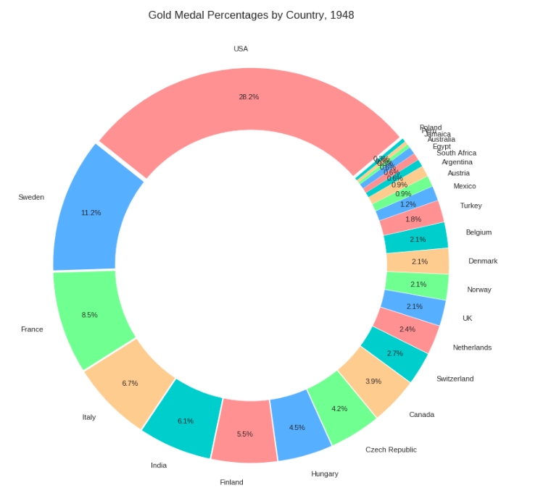
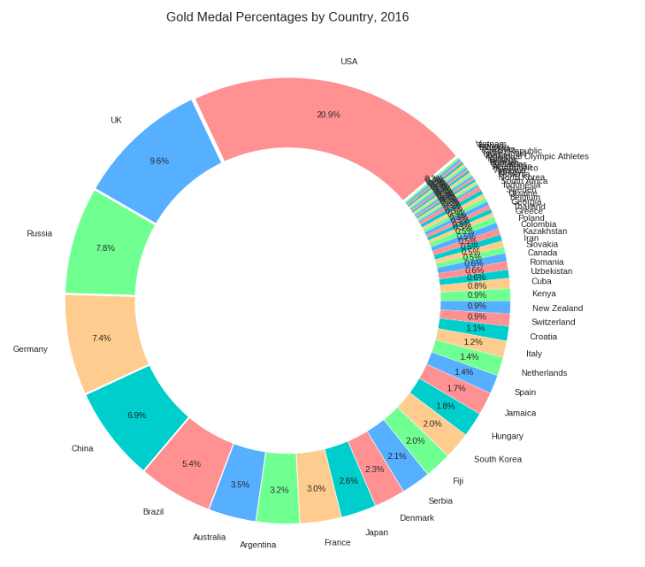

Slide 4
The US has remained a strong performer in gold medal count and overall medal count through time.
In the last 120 years many of the same countries have made prominent medal tallies, but despite Greece’s early dominance they have trailed off drastically.

Slide 5
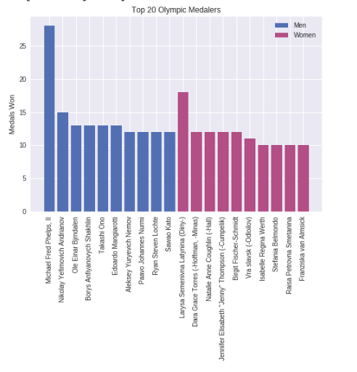
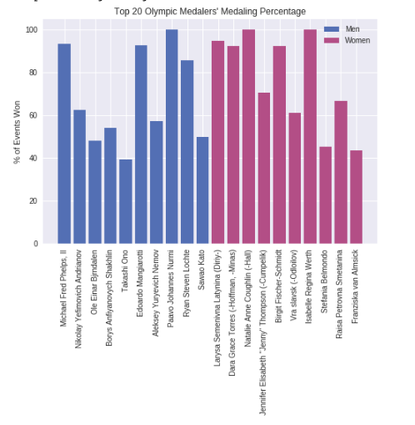
Top Male ~ Michael Phelps, 28 medals
Top Female ~ Larysa Latynina, 18 medals
More distinct pattern among females and medaling percentage

Slide 6
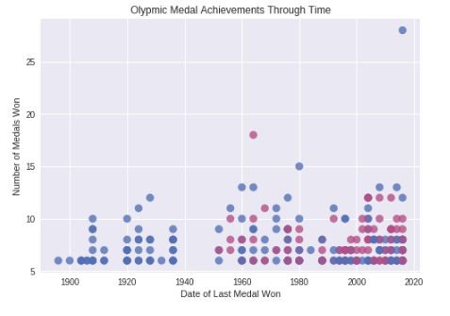
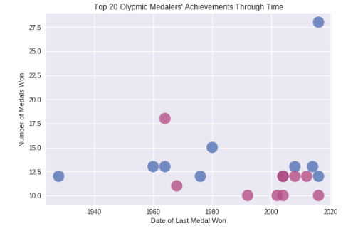
Number of Olympians winning multiple medals has increased

Slide 7
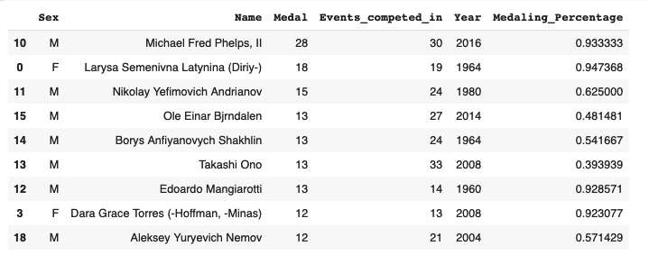
Dataframe to make graphs on two above slides

Slide 8
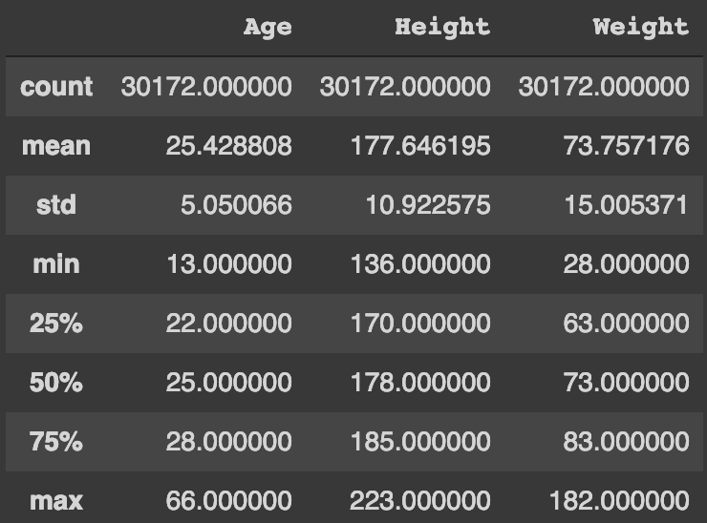
Athletes EDA
Youngest athlete: 13 years old
Average
Age: 25.4 years
Height: 177.65 cm
Weight: 73.76
P(athlete medals) = 0.11128

Slide 9
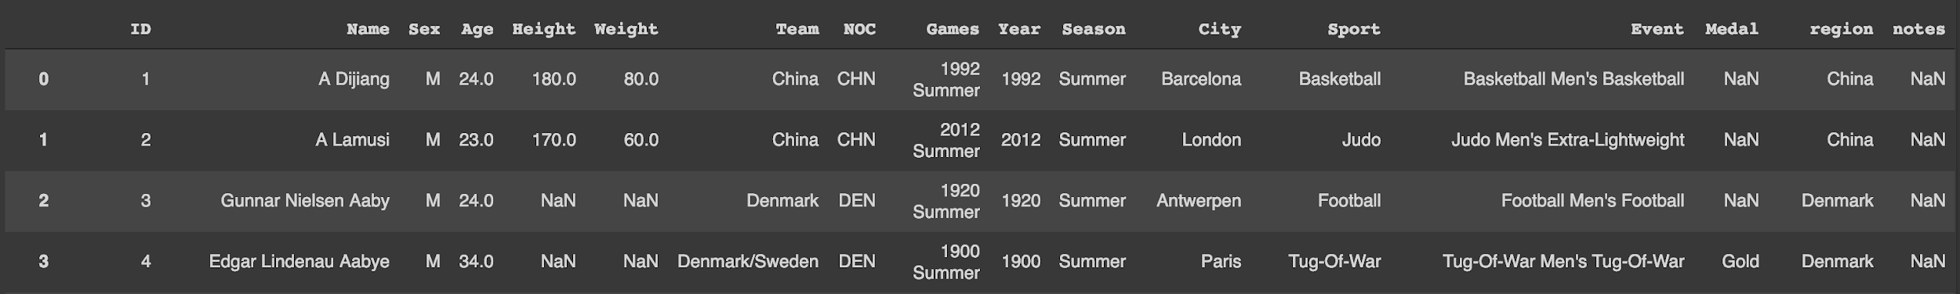
Athletes and Medaling (Cleaning)
Original data frame

Slide 10
Dropped columns:
Over the years, sports have been added/dropped therefore Sport and Event are not suitably testable categories; additionally, the number of medals awarded per event varies so there is inherent statistical significance (e.g. 36 medals awarded in basketball as opposed to 3 medals for many events implies a higher probability of athlete medaling if they play a sport awarding more total medals per year).
ID
Name
Team
Games
City
Sport
Year
Season
Event
NOC

Slide 11
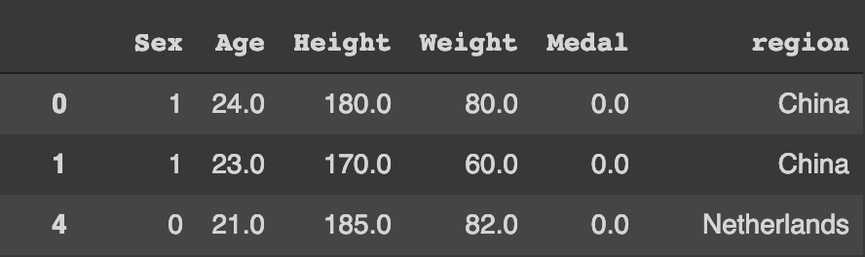
Athletes and Medaling (Cleaning)
Cleaned data frame
Two similar data frames were created
One mapped the medal category with unique values for no medal and each level of medal.
The other mapped the medal category with unique values for gold medalists and non-gold medalists.

Slide 12
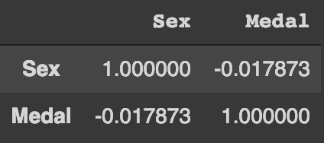
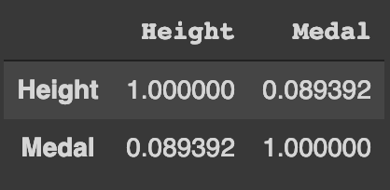
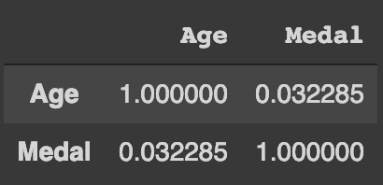
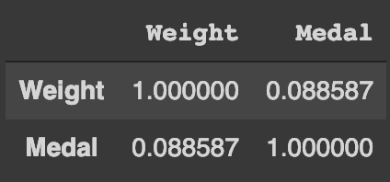
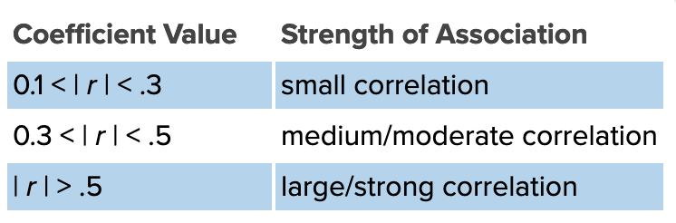
Correlation Testing Methodology
Subset columns of interest into new variable
Run “.corr” method on newly created variable and save result to new variable
Method calculates Pearson’s r for the association between two variables
Note: Most of the computed coefficients of correlation implied a lack of correlation for the tested variables.
Note: Could test dataframe in R with specific hypothesis testing methods and/or simulations using the main dataframe

